Slide 1
https://www.ruthmiskin.com/en/find-out-more/parents/#lg=1&slide=1

Slide 2
Introducing
We have chosen to introduce the program to develop the reading and writing skills across the school.
Read Write Inc. Phonics teaches children to read accurately and fluently with good comprehension. They learn to form each letter, spell correctly, and compose their ideas step-by-step.

Slide 3
Grouping
The program is taught by teachers and TAs to groups of children of a similar ability.
Read Write Inc trained staff/group teachers include – Mrs McGinty, Mrs May, Mr Bradman, Mrs Dallas, Miss Booth, Mrs Lewis and Mrs Mercer.

Slide 4
Grouping
The groups will range from pupils in Reception to pupils in Year Two
We have used an initial assessment to find out what sound knowledge the pupils have.
This assessment provides the basis for our grouping.

Slide 5
Practice
The program uses:-
My turn, your turn for support.
Partner Practice for support.
Signals to limit the ‘teacher talk’ for pace.
Talk out loud – verbalising what the children need to do.

Slide 6
Ditty Reading
Children begin with ‘Ditty Reading.’
These are short stories which encourage the children to point to each word as they read, read with a partner and to ‘Fred Talk’ sounding out words.

Slide 7
Ditty Writing
Children use the reading to develop a sentence, repeating it to commit it to memory and using sounding out to write a shared sentence.

Slide 8
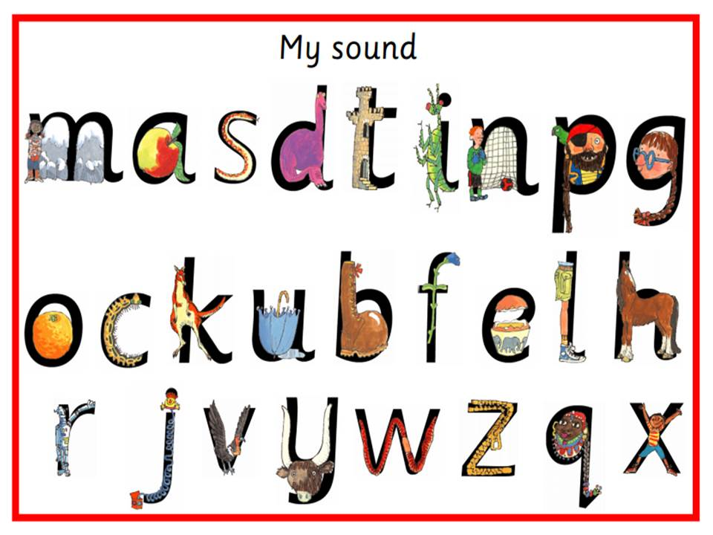
Reading
The children will learn to:
1. Read letters by their ‘sounds’
2. Blend these sounds into words
3. Read the words in a story.

Slide 9
Reading
First, the child will learn to read:
• Set 1 Speed Sounds: these are sounds written with one letter:
m a s d t i n p g o c k u b f e l h r j v
y w z x
Sounds written with two letters: sh th ch
qu ng nk ck ( These are known as ‘special friends’)
• Words containing these sounds, by sound-blending,
e.g. m–a–t mat, c–a–t cat, f–i–sh fish, s–p–l–a–sh splash
• Blending Books and Red, Green and Purple Storybooks.

Slide 10
Reading
Each letter is given a shape picture which matches the initial sound.
• ‘s’ is in the shape of a snake
• ‘d’ is in the shape of a dinosaur
• ‘a’ is in the shape of an apple
• ‘m’ is in the shape of two mountains.
The children will be challenged to read these at speed

Slide 11
Pure Sounds
The children will use ‘pure sounds’ to blend sounds and word build.
https://www.ruthmiskin.com/en/find-out-more/parents/#lg=1&slide=2

Slide 12
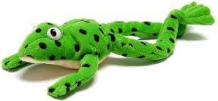
Reading – Fred Talking
Once the children can read Set 1 Speed Sounds confidently they learn to read words using ‘Fred Talking.’ Fred can only say the sounds in a word and needs your child to
help him read the word.
The children will hear and use the term ‘Fred Talk’,
To know they need to sound out the word.
https://www.youtube.com/watch?v=dEzfpod5w_Q

Slide 13
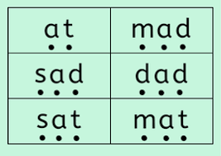
Reading – Fred Talking
The children will see the words and sound out each letter then blend these together.
This may be with three letter cards put together, using green words and in their reading books.
https://www.ruthmiskin.com/en/find-out-more/parents/#lg=1&slide=10
Start 1:16

Slide 14
Reading Books
Pupils will bring home a sounding out book, this will have been read three times with the children in school before it comes home.
They may also bring home a reading bag book – individual reading book, supporting phonics for reading.
Story time will also be used to develop the children’s understanding, by reading books related to the sounding out books being used in the classroom.

Slide 15
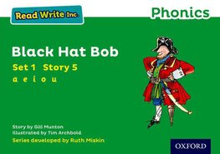
Reading Books

Slide 16
Reading
• Set 2 Speed Sounds: ay ee igh ow oo oo ar or
air ir ou oy
• Words containing these sounds
• Pink, Orange and Yellow Storybooks.
• Set 3 Speed Sounds: ea oi a-e i-e o-e u-e aw
are ur er ow ai oa ew ire ear ure
• Words containing these sounds
• Blue and Grey Storybooks.

Slide 17
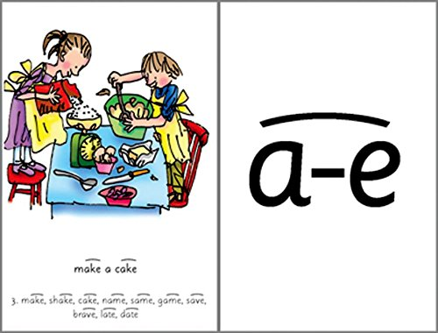
Reading

Slide 18
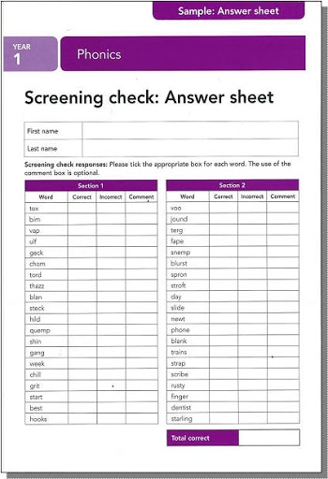
Phonics Screening Check
The Phonics Screening Check is meant to show how well your child can use the phonics skills they've learned up to the end of Year 1, and to identify students who need extra phonics help.
https://www.ruthmiskin.com/en/find-out-more/parents/#lg=1&slide=4

Slide 19
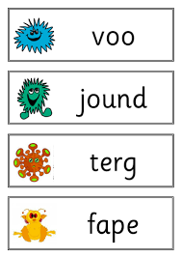
Phonics Screening Check
Nonsense or ‘alien’ words are part of the check.
Includes nonsense words but does not repeat these.

Slide 20
Phonics Sessions
Pupils will look at new sounds, using their phonics picture.
Practice known speed sounds.
Blend speed sound words.
Write the sound.
Spell speed sound words, using ‘Fred Fingers.’
Fred Talk words.

Slide 21
Remember For Reading
Read with ‘Pure Sounds.’
Support with ‘Fred Talk.’
Read stories to your child with feeling!
The more you love the story, the more
your child will love reading.
Read books more than once to develop confidence and familiarity.

Slide 22
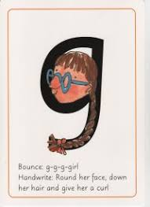
Handwriting
The children will use
The sayings with each letter to help them form the letter.
These link to the phonics picture.
https://www.ruthmiskin.com/en/find-out-more/parents/#lg=1&slide=9
Just show parent demonstration 1:42

Slide 23
Writing
Writing will be linked to the stories the children have been reading.
The stories will be discussed, thoroughly to develop comprehension skills.
Sentences will be developed with the pupils and writing activities will relate to their reading.

Slide 24
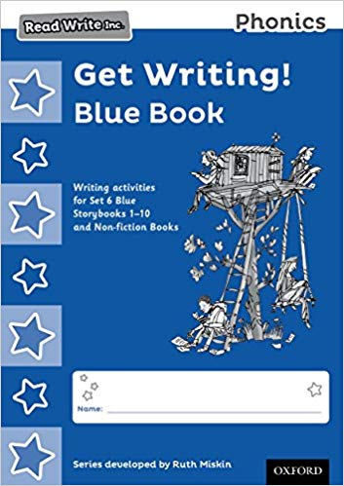
Writing
As children move through the program, grammar and varied vocabulary will become a focus for writing.
Children will practice spelling words covered in the sessions.

Slide 25
Reading Tips
https://www.ruthmiskin.com/en/find-out-more/parents/#lg=1&slide=5

